Slide 1


Introduction to ZipeBite: Revolutionizing the Online Food System
Welcome to the future of online food! ZipeBite is a new platform designed to connect customers and restaurants in a seamless and efficient way.

Slide 2
The Challenges in the Traditional Food Ecosystem
Traditional food systems of indigenous peoples are based on local access to a diversity of naturally resilient food services
Options
low Fees
Selection of cuisine of food offer a multiple cuisines, leaving customers with multiple choices.
Low fees or charges can make ordering food, online for pocket-friendly, especially families and groups.

Slide 3



ZipeBite's Vision: Connecting Customers & Restaurants
Goals
Increased Profit
Strategy
Increase Sales
Target New Customer
New Products
Brand Messaging
Tagline
Brand holding
Advertisement
Branding
Customer Experience : Simple & Efficient
Restaurant Management : Tools & Insights
Food Ecosystem : Sustainable & Fair

Slide 4





The ZipeBite Platform: A Seamless Digital Experience
Search & Discover
Explore Menus
Order & Track
Secure Payment
Easily browse local restaurants and cuisines with filters and personalized recommendations.
View detailed menus with photos, descriptions, and nutritional information.
Place orders securely and track their progress in real-time.
Choose from multiple payment options, including digital wallets and credit cards.

Slide 5


Animation: Walkthrough of the Online Food System
Imagine a seamless experience where you can easily find your favorite restaurants, explore their menus, place your order, and track it all in one intuitive app.

Slide 6
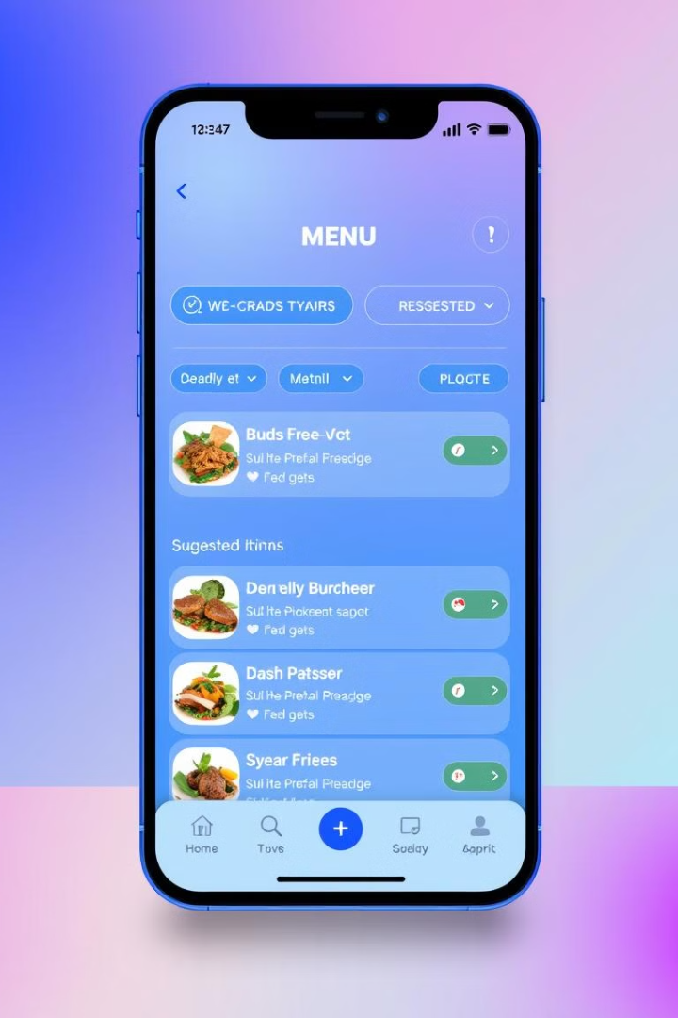
Key Features: Personalized Menu & Easy Ordering
1
Personalized Recommendations
2
Order Customization
Get tailored suggestions based on your past orders and preferences.
Add or remove ingredients, adjust portion sizes, and create your perfect meal.
3
Fast Checkout
Save your payment information for faster and easier checkout.

Slide 7

Benefits for Customers: Convenience, Variety, and Transparency
Convenience
Variety
Transparency
Order your food from your table inside restaurants anytime.
Explore a wide range of cuisines and dining options, from casual to fine dining.
See nutritional information, ingredient lists, and reviews to make informed decisions.

Slide 8
Advantages for Restaurants: Increased Visibility and Expanded Reach
Wider Audience
1
Reach new customers beyond your physical location.
Direct Connection
2
Build relationships with customers through personalized interactions.
Streamlined Operations
3
Manage orders efficiently and receive payments securely.

Slide 9
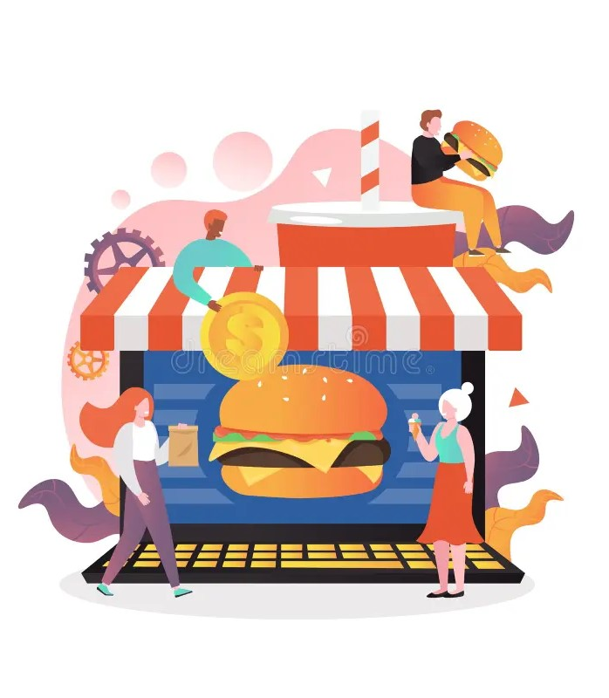
The Future of ZipeBite: Scaling the Online Food Revolution
ZipeBite is committed to connecting customers and restaurants across the globe, making the online food experience more convenient, accessible, and enjoyable.

Slide 10

Any Questions ?

Slide 11
THANK YOU
By : Shyamsunder.Prajapati

